Slide 1
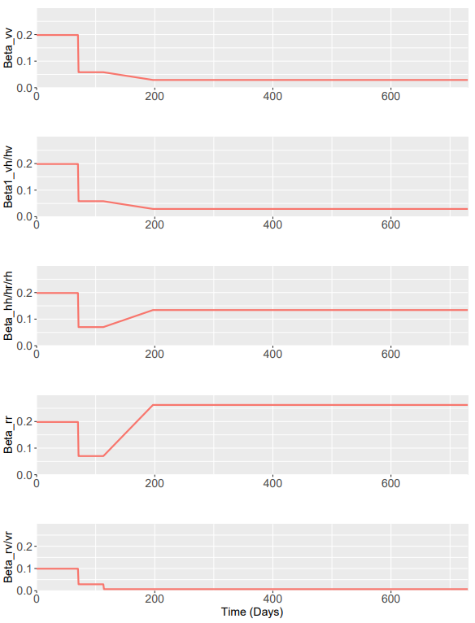
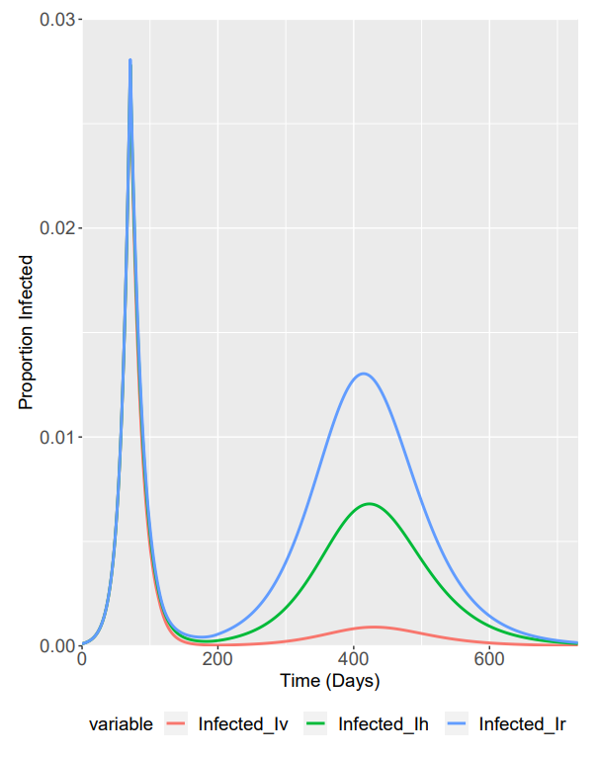
For δ = 0.5
β₄ = β₁ * δ for phase 1/2
β₄ = (β₁ * δ) * 0.25 for phase 3
Betas before 1/3 scaling

